Slide 1
PRINCIPLES OF INTERFACE GOOD SCREEN DESIGN
What users want and do
Interface design goals
The test for a good design
Organizing screen elements
Navigation and flow
Visually pleasing composition
Typography
Keying procedures
Data output
Web sites and Web pages
Statistical graphics
Technological considerations

Slide 2
HOW TO DISTRACT THE SCREEN USER
Visual inconsistency
Lack of restraint in the use of design features and elements
Overuse of three-dimensional presentations
Overuse of bright colors
Poorly designed icons
Bad typography

Slide 3
HOW TO DISTRACT THE SCREEN USER
Numerous visual and auditory interruptions
Extensive visual clutter
Poor information readability
Incomprehensible screen components
Confusing and inefficient navigation
Inefficient operations and extensive waste of user time
Excessive or inefficient page scrolling
Information overload
Design inconsistency
Outdated information
Stale design caused by emulation of printed documents and past systems

Slide 4
WHAT SCREEN USERS WANT
An orderly, clean, clutter-free appearance
An obvious indication of what is being shown and what should be done with it
Expected information located where it should be
A clear indication of what relates to what, including options, headings, captions, data, and so forth
Plain, simple English
A simple way of finding out what is in a system and how to get it out
A clear indication of when an action can make a permanent change in the data or system

Slide 5
WHAT SCREEN USERS DO
Identify a task to be performed or need to be fulfilled.
Decide how the task will be completed or the need fulfilled.
Manipulate the computer’s controls.
Gather the necessary data.
Form judgments resulting in decisions relevant to the task or need.

Slide 6
INTERFACE DESIGN GOALS
Reduce visual work
Reduce intellectual work
Reduce memory work
Reduce motor work
Minimize or eliminate any burdens or instructions imposed by technology

Slide 7
THE TEST FOR GOOD DESIGN
Can all screen elements
be identified by cues other
than by reading the words
that make them up?

Slide 8
MEANING AND PURPOSE
Each screen element...
Every control
All text
The screen organization
All emphasis
Each color
Every graphic
All screen animation
Each message
All forms of feedback
Must...
Have meaning to screen users
Serve a purpose in performing tasks

Slide 9
ORGANIZING SCREEN ELEMENTS CLEARLY AND MEANINGFULLY
Consistency
Provide real-world consistency
Provide internal consistency, including:
Operational and navigational procedures
Visual identity or theme
Component:
Organization
Presentation
Usage
Locations
Follow the same conventions and rules across all related interfaces
Deviate only when there is a clear benefit for the user

Slide 10
ORGANIZING SCREENS
Ordering of Screen Data and Content
Divide information into units that are logical, meaningful, and sensible.
Organize by the degree interrelationship between data or information.
Provide an ordering of screen units of information and elements that is prioritized according to the user’s expectations and needs.
Possible ordering schemes include:
Conventional
Sequence of Use
Frequency of Use
Function/category
Importance
General to specific
Form groups that cover all possibilities.
Ensure that information that must be compared is visible at the same time
Ensure that only information relative to the users tasks or needs is presented on the screen

Slide 11
ORGANIZING SCREENS
Starting Point
Provide an obvious starting point in the screen’s upper-left corner.
Focus user's attention to the most important part of a screen or page.

Slide 12
Step 3 ORGANIZING SCREENS
Ordering Web Pages
Establish levels of importance.
Place critical information near the top of Web site.
Place important items near the top of a page.
Organize information clearly.
Place important items consistently.
Facilitate scanning.
Structure for easy comparison.

Slide 13
Step 3 ORGANIZING SCREENS
Navigation and Flow
Provide an ordering of screen information and elements that:
Is rhythmic, guiding the eye through the display
Encourages natural movement sequences
Minimizes pointer and eye movement distances
Locate the most important and most frequently used elements or controls at the top left
Maintain a top-to-bottom, left-to-right flow
Assist in navigation through a screen by:
Aligning elements
Grouping elements
Using of line borders

Slide 14
Step 3 ORGANIZING SCREENS
Navigation and Flow (Continued)‏
Through focus and emphasis, sequentially, direct attention to items that are:
Critical
Important
Secondary
Peripheral
Tab through window in logical order of displayed information.
Locate command buttons at end of the tabbing order sequence.
When groups of related information must be broken and displayed on separate screens, provide breaks at logical or natural points in the information flow.

Slide 15
Step 3 ORGANIZING SCREENS
Qualities of Visually Pleasing Composition
Balance
Provide an equal weight of screen elements, left and right, top and bottom
Symmetry
Replicate elements left and right of the screen centerline
Regularity
Establish standard and consistently spaced horizontal and vertical alignment points
Use similar element sizes, shapes, colors, and spacing
Predictability
Be consistent in following conventional orders or arrangements

Slide 16
Step 3 ORGANIZING SCREENS
Qualities of Visually Pleasing Composition (Continued)‏
Sequentiality
Arrange elements to guide the eye in an obvious, logical, rhythmic, and efficient manner
Economy
Use as few styles, display techniques, and colors as possible
Unity
Use similar sizes, shapes, or colors for related information
Leave less space between elements of a screen than the space left at the margins
Proportion
Create windows and groupings of data or text with aesthetically pleasing proportions

Slide 17
Step 3 ORGANIZING SCREENS
Qualities of Visually Pleasing Composition (Continued)‏
Simplicity
Optimize the number of elements on a screen, within limits of clarity
Minimize the alignment points, especially horizontal or columnar
Provide standard grids of horizontal and vertical lines to position elements
Groupings
Provide functional groupings of associated elements
Create spatial groupings as closely as possible to five degrees of visual angle (1.67 inches in diameter)‏
Evenly space controls within a grouping
Visually reinforce groupings:
Separation through use of white space
Provide line borders around groups
Provide meaningful groupings

Slide 18
Step 3 ORGANIZING SCREENS
Perceptual Principles and Grouping
Use visual organization to create functional groupings
Combine visual organization principles in logical ways
Avoid visual organization principles that conflict

Slide 19
Step 3 ORGANIZING SCREENS
Grouping Using White Space
Provide adequate separation between groupings through liberal use of white space
For Web pages, carefully consider the trade-off between screen white space and the need for scrolling

Slide 20
Step 3 ORGANIZING SCREENS
Grouping Using Borders
Incorporate line borders for:
Focusing attention on groupings or related information
Guiding the eye through the screen
Do not exceed three lines styles or two line thicknesses on a screen
Use a standard hierarchy for line presentation
Create lines consistent in height and length
Leave consistent padding space between the information and the line borders
For adjacent groupings align borders left, right, top and bottom
Use rules and borders sparingly
In Web page design:
Be cautious in using horizontal lines as separators between page sections
Reserve horizontal lines for for situations in which the difference between adjacent sections must be emphasized

Slide 21
Step 3 ORGANIZING SCREENS
Grouping Using Backgrounds
Consider incorporating a contrasting background for related information
The background should not have the emphasis of the screen component being attended to
Consider about a 25 percent gray screening
Reserve higher contrast or emphasizing techniques for screen components to which attention should be drawn

Slide 22
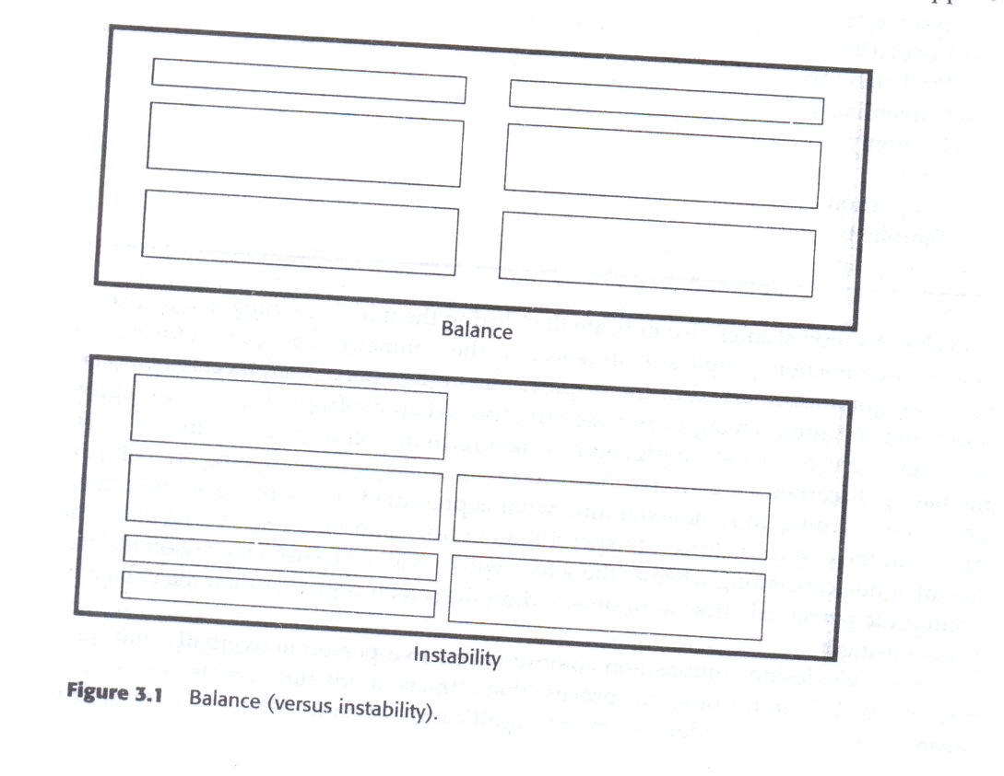
Balance

Slide 23
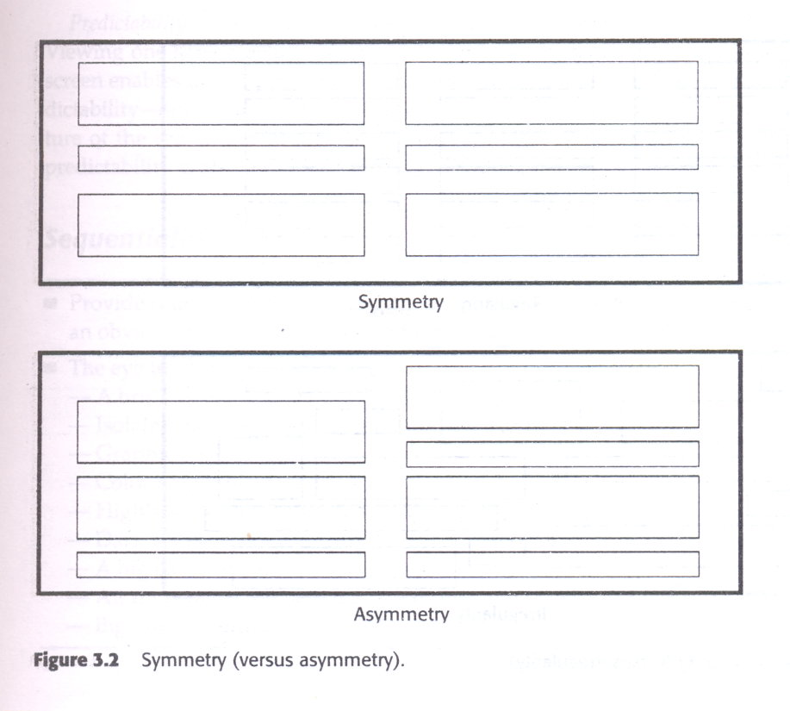
symmetry

Slide 24
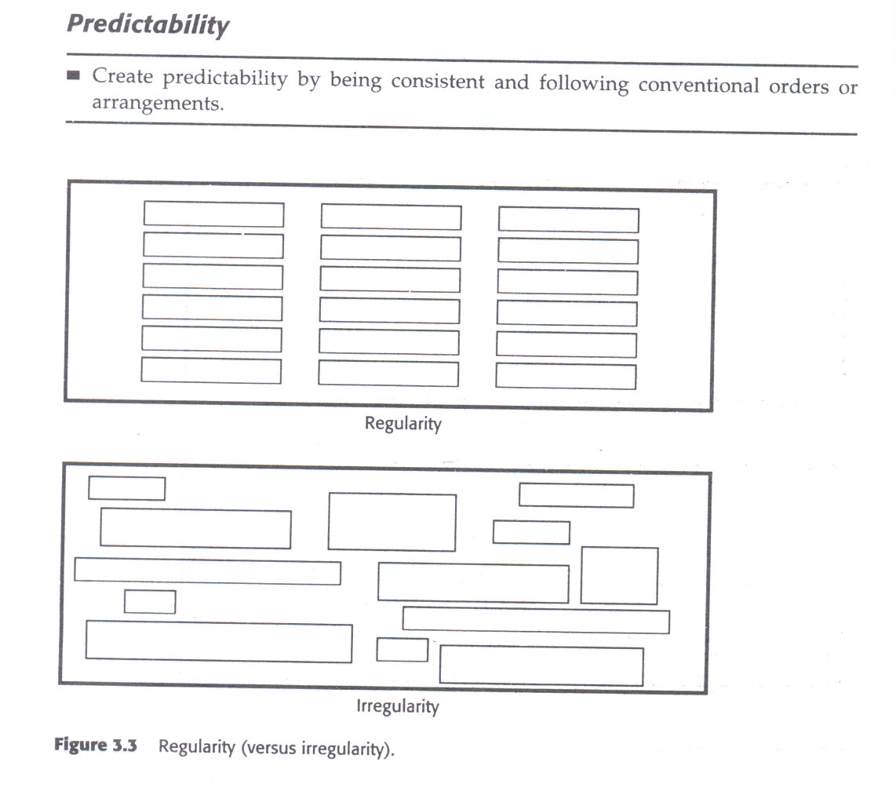
Regularity

Slide 25
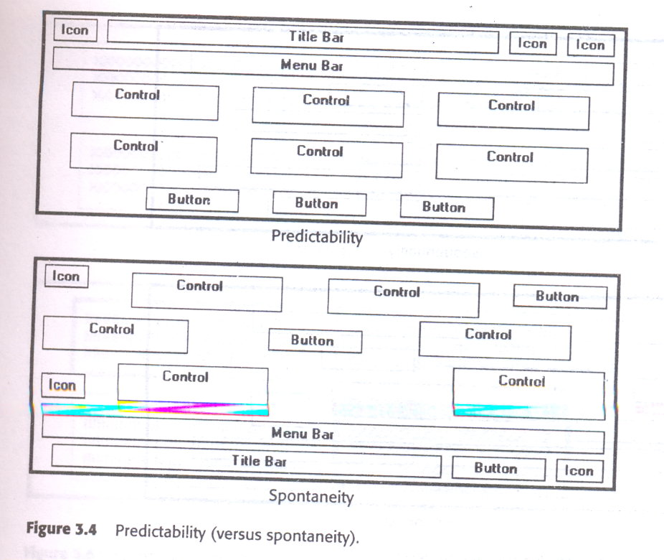
Predictability

Slide 26
sequentially
The eye trends to be attracted to :
A brighter element before one less bright
Isolated elements before elements in a group
Graphics before text
Color before black and white
Highly saturated colors before those less saturated.
Dark areas before light areas
A big element before a small one
An unusual shape before a usual one
Big objects before little objects

Slide 27
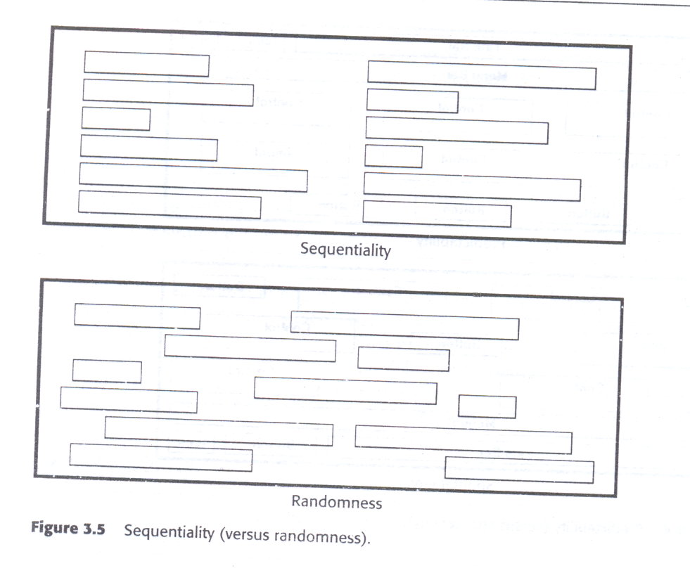

Slide 28
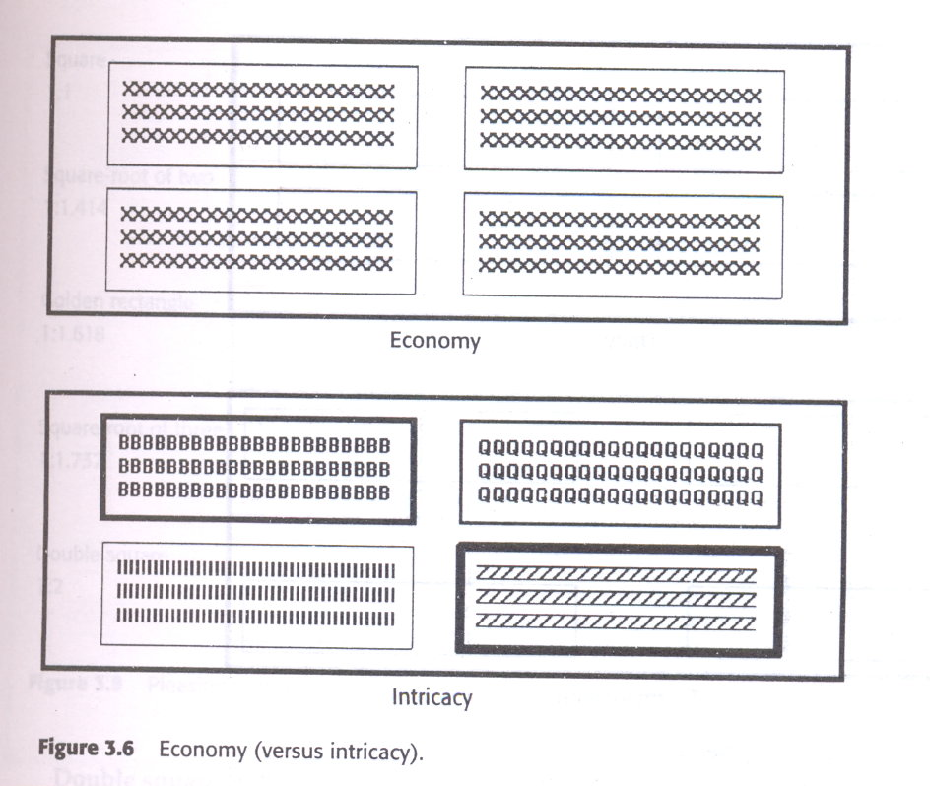

Slide 29
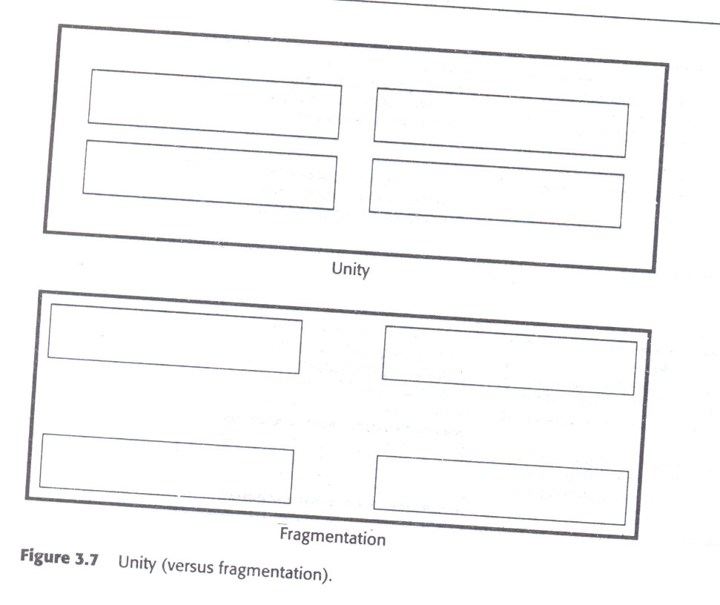

Slide 30
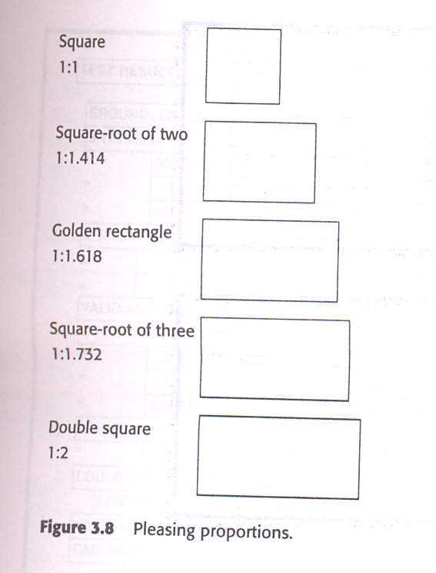

Slide 31
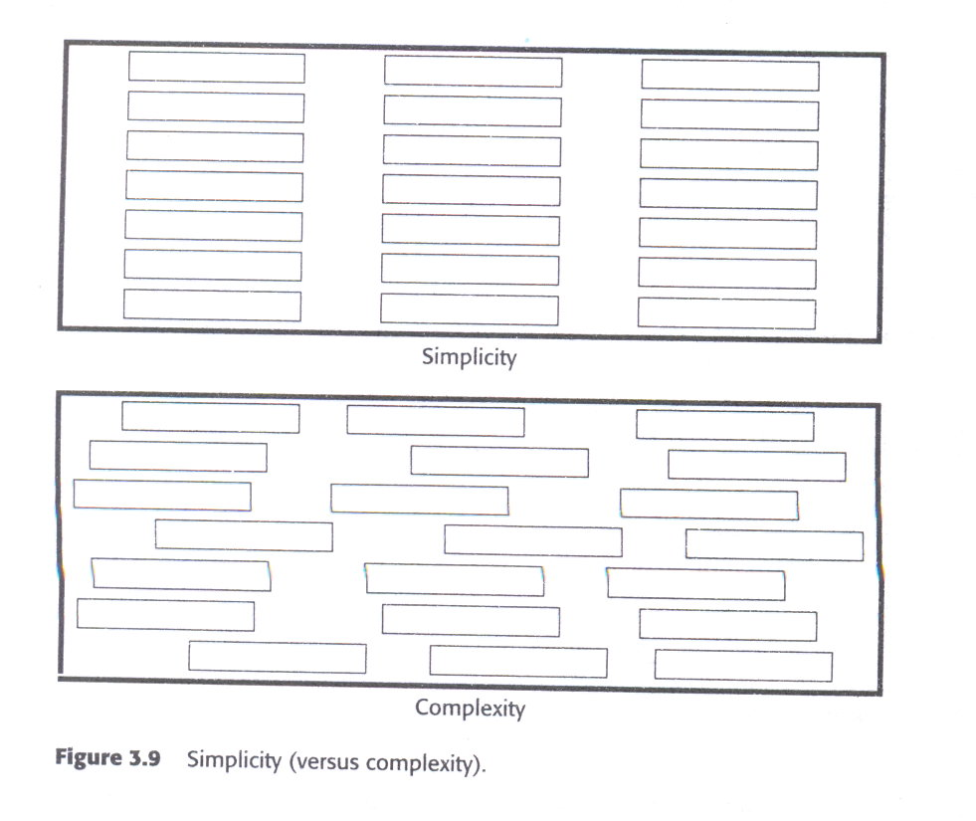

Slide 32
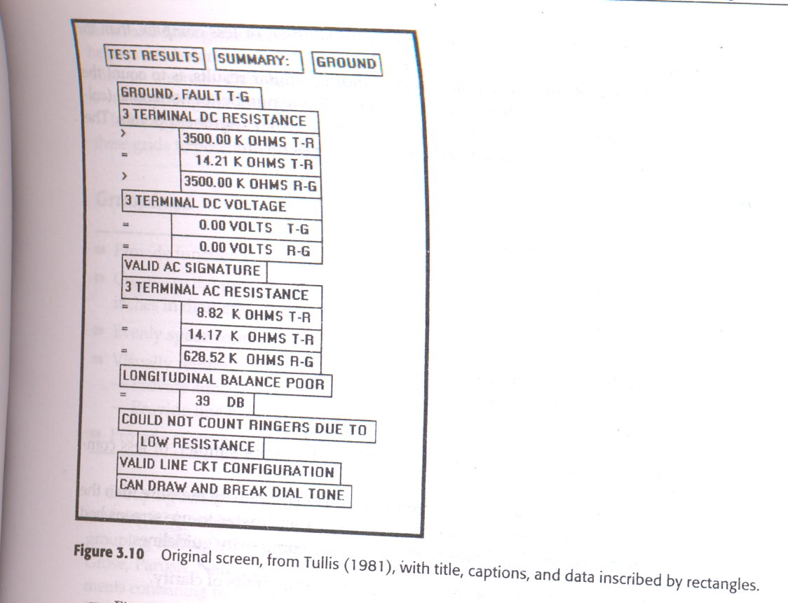

Slide 33
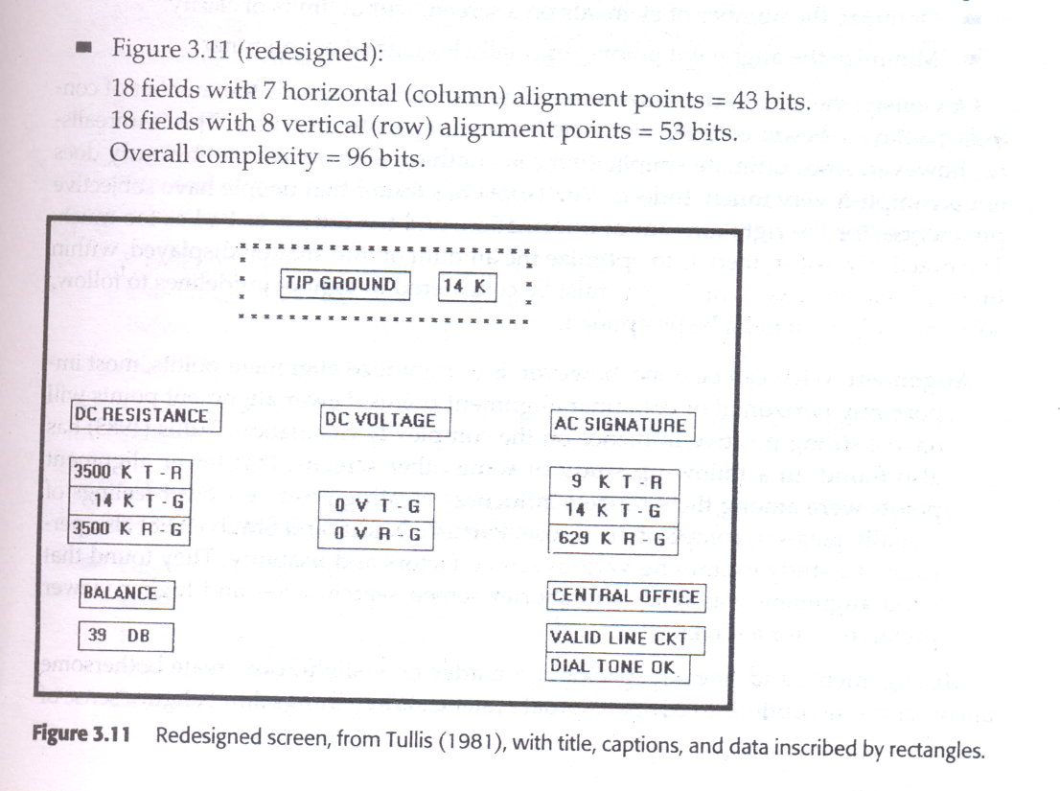

Slide 34
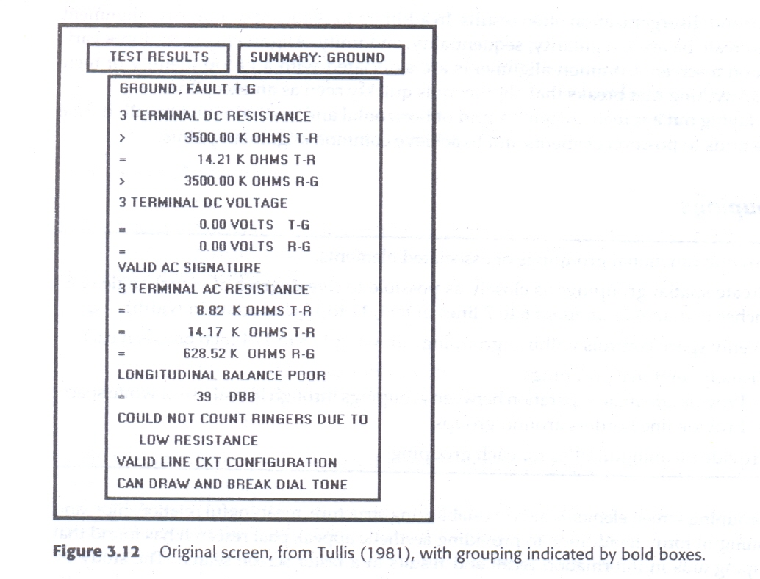

Slide 35
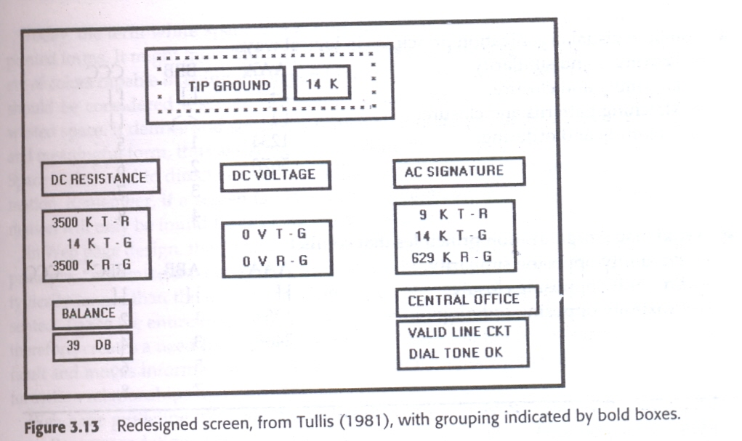

Slide 36
Grouping using borders
Provide functional groupings
Create spatial groupings
Provide meaningful titles for aech grouping
Incorporate line borders
Do not exceed three line thickness
Create lines consistent in height and length
For adjacent groupings with borders whereever possible
Use rules and borders sparingly

Slide 37
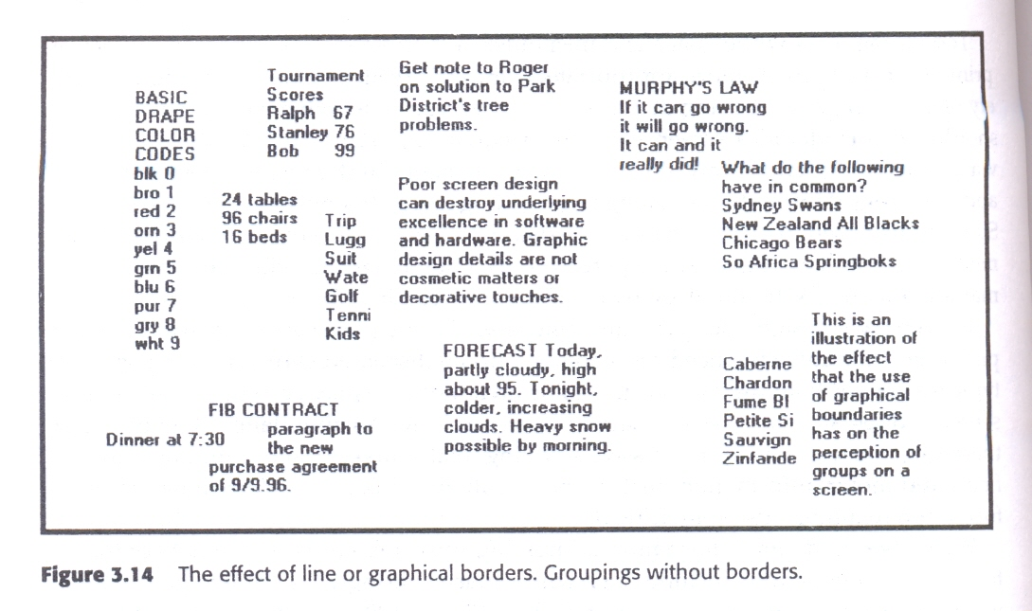

Slide 38
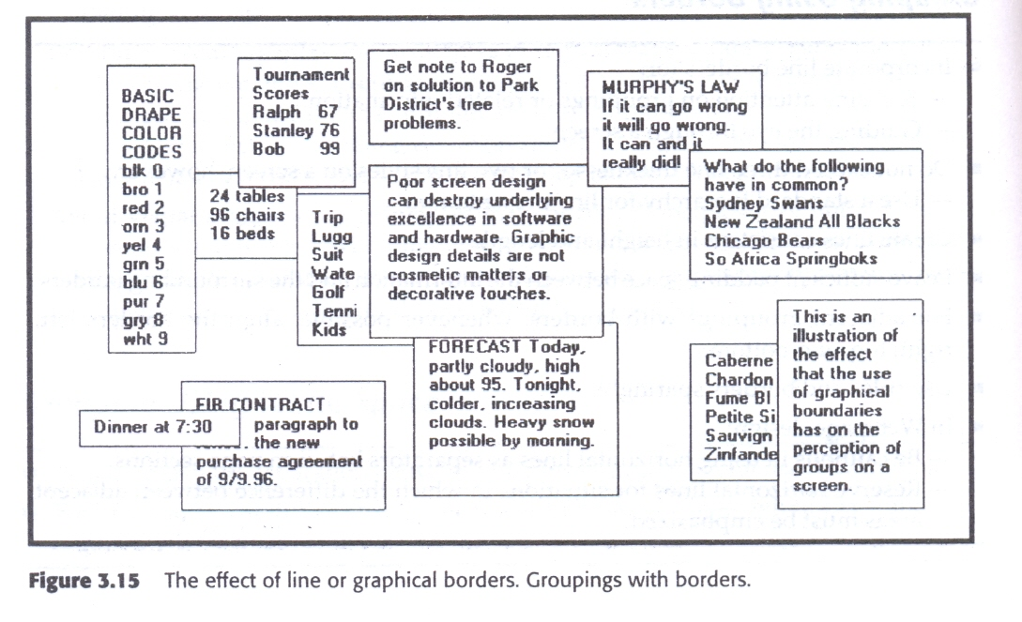

Slide 39
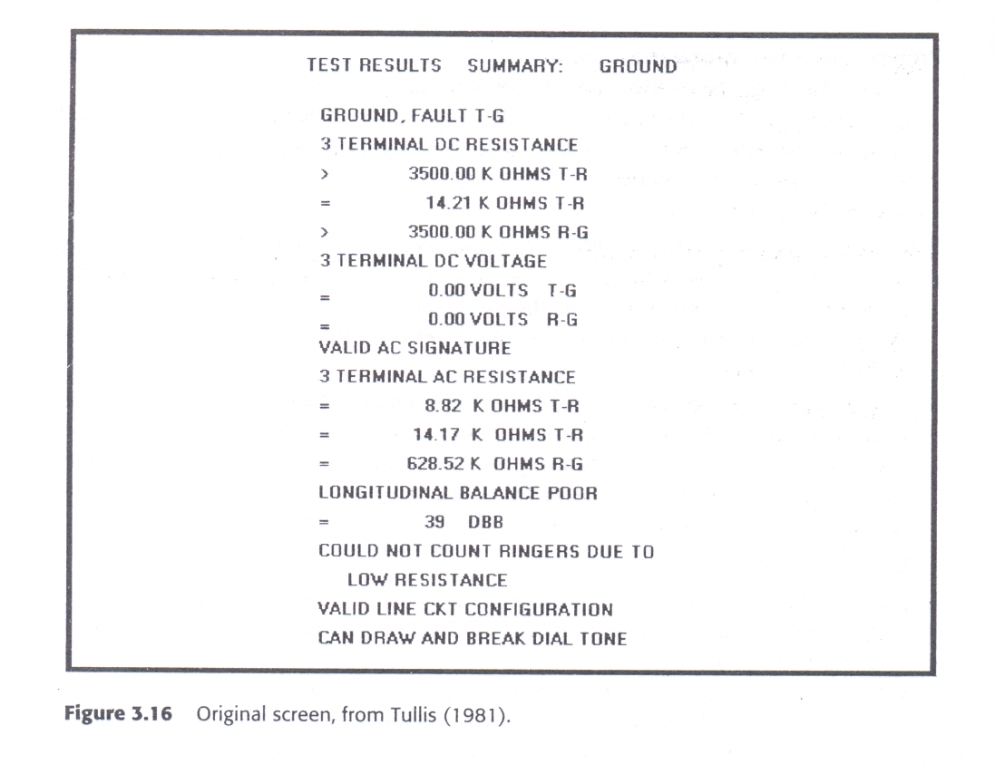

Slide 40
